Slide 1
A Systems Approach to Exposure Modeling (ExpoCast)
John Wambaugh
National Center for Computational Toxicology
Office of Research and Development
U.S. Environmental Protection Agency
FutureTox III: Bridges for Translation
Arlington, Virginia
November 19-20, 2015
The views expressed in this presentation are those of the author and do not necessarily reflect the views or policies of the U.S. EPA
ORCID: 0000-0002-4024-534X

Slide 2
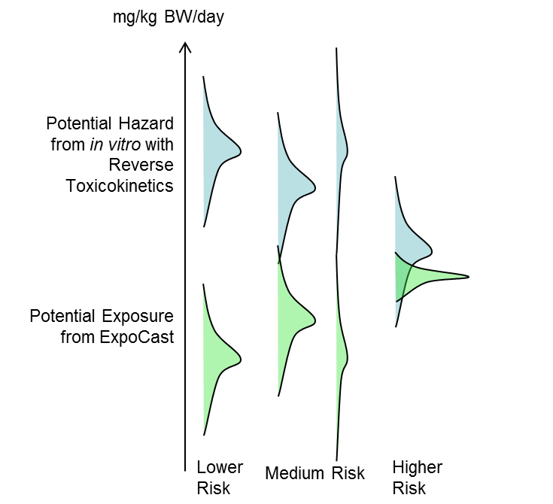
Introduction
The timely characterization of the human and ecological risk posed by thousands of existing and emerging commercial chemicals is a critical challenge
High throughput risk prioritization relies on three components:
high throughput hazard characterization
high throughput exposure forecasts
high throughput toxicocokinetics (i.e., dosimetry)
While advances have been made in HT toxicity screening, exposure methods applicable to 1000s of chemicals are needed

Slide 3
Scale of the Problem
Park et al. (2012): At least 3221 chemicals in humans, many appear to be exogenous
Endocrine Disruptor Screening Program (EDSP) Chemical List | Number of Compounds
Conventional Active Ingredients | 838
Antimicrobial Active Ingredients | 324
Biological Pesticide Active Ingredients | 287
Non Food Use Inert Ingredients | 2,211
Food Use Inert Ingredients | 1,536
Fragrances used as Inert Ingredients | 1,529
Safe Drinking Water Act Chemicals | 3,616
TOTAL | 10,341
EDSP List 2 (2013)
107 Chemicals
EDSP Chemical Universe
10,000 chemicals
(FIFRA & SDWA)
EDSP List 1 (2009)
67 Chemicals
So far 67 chemicals have completed testing and an additional 107 are being tested
December, 2014 Panel: “Scientific Issues Associated with Integrated Endocrine Bioactivity and Exposure-Based Prioritization and Screening“ DOCKET NUMBER: EPA–HQ–OPP–2014–0614

Slide 4

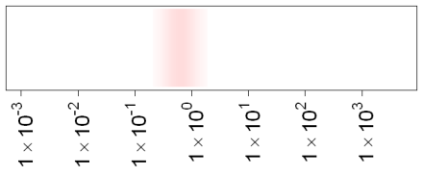
High-Throughput Bioactivity
Tox21: Examining >10,000 chemicals using ~50 assays intended to identify interactions with biological pathways (Schmidt, 2009)
ToxCast: For a subset (>1000) of Tox21 chemicals ran >500 additional assays (Judson et al., 2010)
Most assays conducted in dose-response format (identify 50% activity concentration – AC50 – and efficacy if data described by a Hill function)
All data is public: http://actor.epa.gov/
In vitro Assay AC50
Response
Concentration
Assay AC50
with Uncertainty
Concentration (μM)

Slide 5
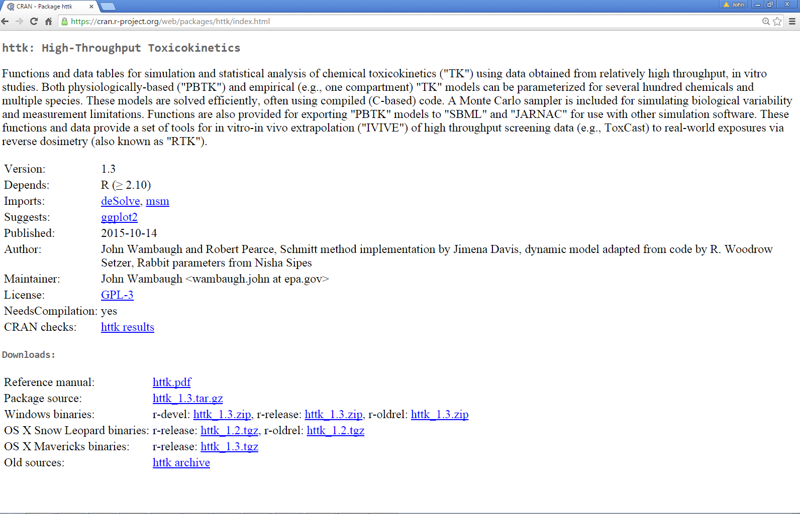
High-Throughput Toxicokinetics
Lower 95%
Predicted C_{ss}
Median
Predicted C_{ss}
Upper 95%
Predicted C_{ss}
Oral Equivalent Daily Dose
0
Steady-state Concentration (μM) = in vitro AC50
Open source In Vitro-In Vivo Extrapolation and Physiological-based Toxicokinetics
Environmental
Partitioning
Biological
Partitioning
Inhaled Gas
Lung Tissue
Q_{cardiac}
Dust
Biota
Venous Blood
Lung Blood
Arterial Blood
Q_{GFR}
Kidney Tissue
Q_{kidney}
Air
Proteins
Kidney Blood
“httk” R Package
543 Chemicals to date
Lead programmer Robert Pearce
Wambaugh et al. (2015), Pearce et al. submitted
C
Neutral
lipid
Gut Lumen
water vapor
N
Q_{gut}
Sediment
A
Gut Blood
Water
Acidic
phospholipid
Liver Tissue
Q_{metab}
Liver Blood
Q_{gut}
Soil
Q_{liver}
Rest of Body
Body Blood
Q_{rest}
https://cran.r-project.org/web/packages/httk/
Can access from the R GUI: “Packages” then “Install Packages”

Slide 6
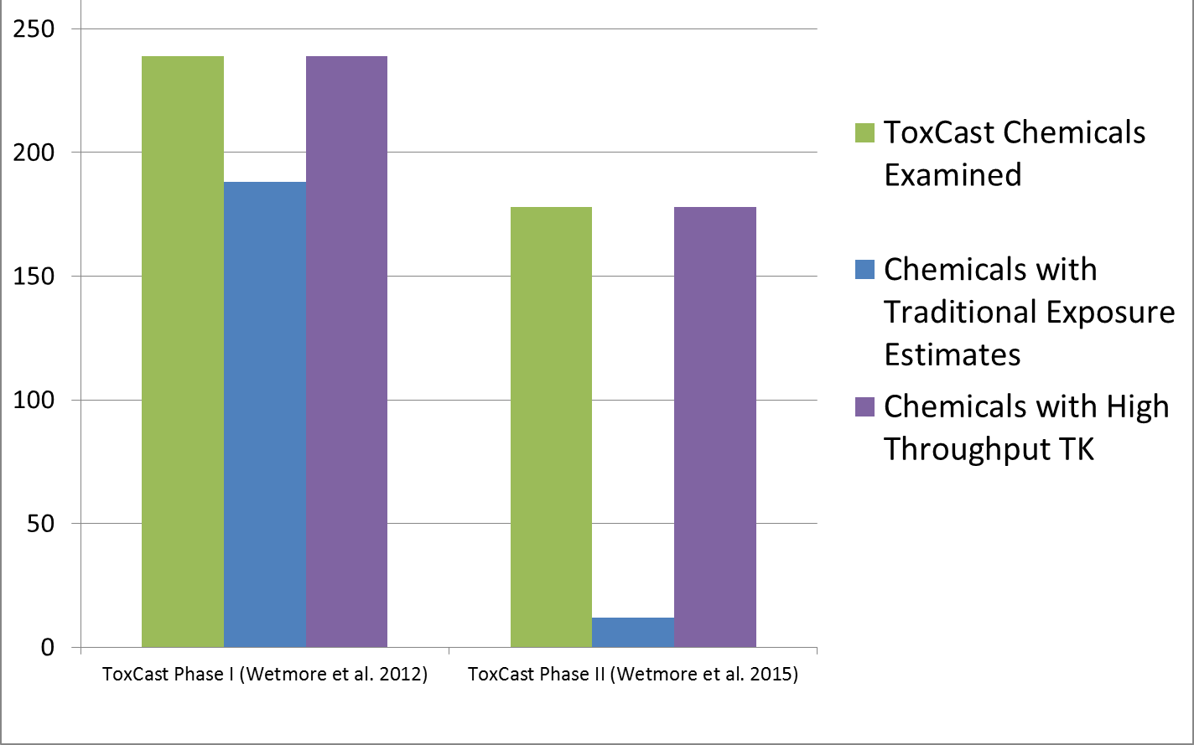
High Throughput Screening (HTS), HT Toxicokinetics (HTTK), and Exposure
For non-pesticide chemical space, there is a paucity of data for providing context to HTS data (Egeghy et al. (2012))

Slide 7
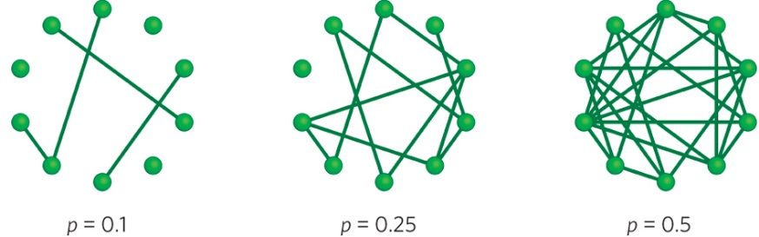
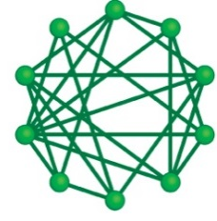
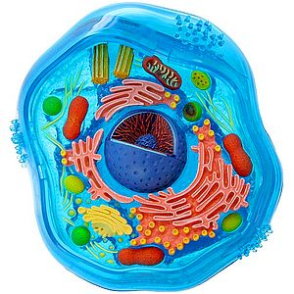
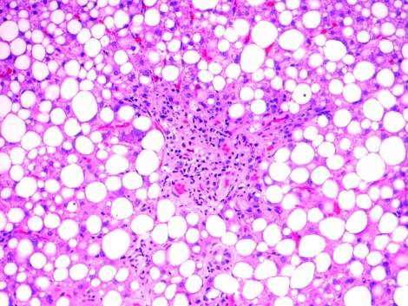
Why “Systems Exposure”?
GENE
GENE
GENE
GENE
BIOMOLECULES
PATHWAYS
Systems Biology:
Interactions on multiple scales integrated into a homeostatic system
CELLS
PHENOTYPES
see also Pleil and Shelden (2011)

Slide 8
Why “Systems Exposure”?
GENE
GENE
GENE
GENE
BIOMOLECULES
PATHWAYS
Chemical
Systems Toxicology:
Chemical perturbations of homeostasis
CELLS
PHENOTYPES
see also Pleil and Shelden (2011)

Slide 9
Systems Exposure
Chemical Manufacture
Consumer
Products, Articles, Building Materials
Environmental Release
Direct Use
(e.g., lotion)
Residential Use
(e.g. ,flooring)
Waste
MEDIA
Air, Dust, Surfaces
Food
Air, Soil, Water
Near-Field
Direct
Near-Field
Indirect
Dietary
Far-Field
Ecological
Human
Ecological
Flora and Fauna
RECEPTORS
MONITORING
DATA
Biomarkers
of Exposure
Media Samples
Biomarkers
of Exposure
see also Pleil and Shelden (2011)
Figure from Kristin Isaacs

Slide 10
Exposure Pathways
Chemical Manufacture
Consumer
Products, Articles, Building Materials
Environmental Release
Direct Use
(e.g., lotion)
Residential Use
(e.g. ,flooring)
Waste
MEDIA
Air, Dust, Surfaces
Food
Air, Soil, Water
EXPOSURE
PATHWAY
(MEDIA + RECEPTOR)
Near-Field
Direct
Near-Field
Indirect
Dietary
Far-Field
Ecological
Human
Ecological
Flora and Fauna
RECEPTORS
MONITORING
DATA
Biomarkers
of Exposure
Media Samples
Biomarkers
of Exposure
see also Pleil and Shelden (2011)
Figure from Kristin Isaacs

Slide 11
Predicting Systematic Response
Observation
Prediction

Slide 12
Consensus Exposure Predictions with the SEEM Framework
Incorporate multiple models into consensus predictions for 1000s of chemicals within the Systematic Empirical Evaluation of Models (SEEM) framework (Wambaugh et al., 2013, 2014)
Evaluate/calibrate predictions with available monitoring data across as many chemical classes as possible to allow extrapolation
Analogous efforts for both human and ecological exposures

Slide 13
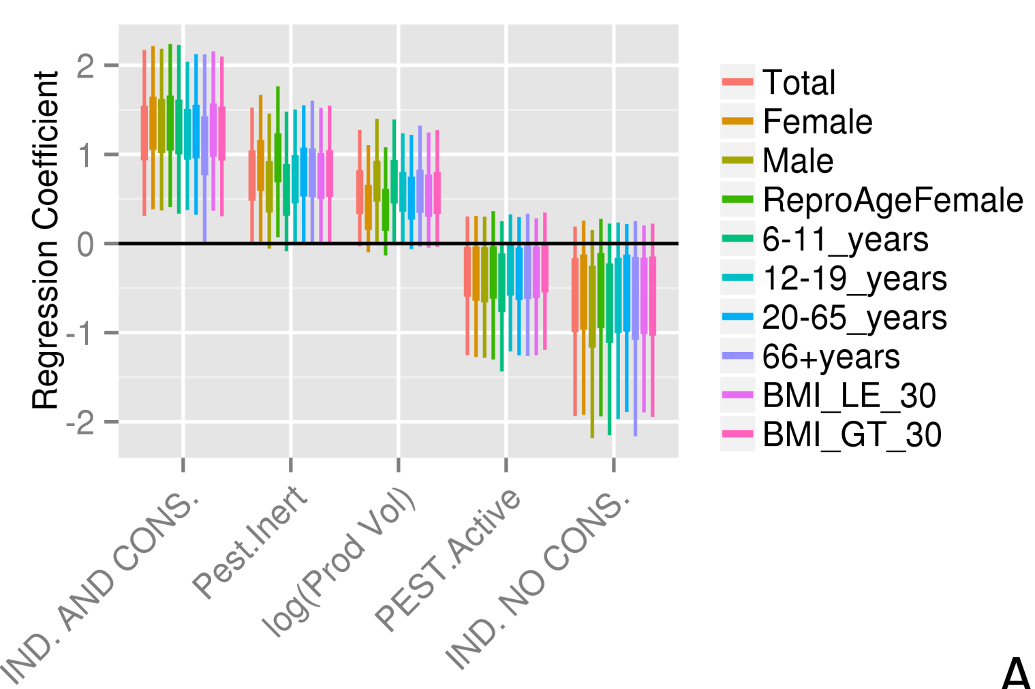
Calibrated Exposure Predictions for 7968 Chemicals
R² ≈ 0.5 indicates that we can predict 50% of the chemical to chemical variability in mean NHANES exposure rates
Same five predictors work for all NHANES demographic groups analyzed – stratified by age, sex, and body-mass index:
Industrial and Consumer use
Pesticide Inert
Pesticide Active
Industrial but no Consumer use
Production Volume
Wambaugh et al. (2014)

Slide 14
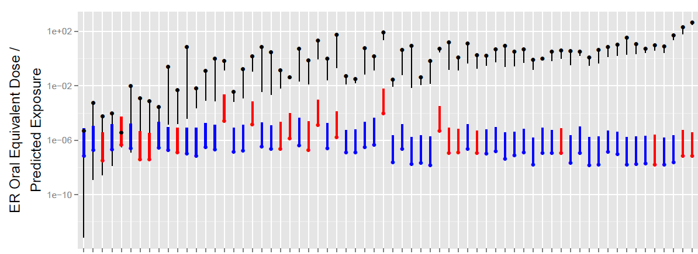
Application to High Throughput Risk Prioritization
Prioritization as in Wetmore et al. (2012) Bioactivity, Dosimetry, and Exposure Paper
ToxCast-derived Receptor Bioactivity Converted to mg/kg/day with HTTK
ExpoCast
Exposure Predictions
Near Field
Far Field
ToxCast Chemicals
December, 2014 Panel:
“Scientific Issues Associated with Integrated Endocrine Bioactivity and Exposure-Based Prioritization and Screening“
Also see poster “Computational Models to Correlate In Vitro to In Vivo Activity” by Nisha Sipes and Steve Ferguson, et al.
Notes:
Haluk:
The circles are ToxCast Phase I (human toxicity-relevant bioactivity assay) AC50s transformed using in vitro measures of human metabolic clearance and plasma protein to constant infusion doses that would produce steady-state serum concentrations equal to the in vitro AC50s. This slide is animated, and when clicked most of the exposure estimates disappear. At this point this is a cartoon description of what Phase II of ToxCast will look like, but is not actual Phase II data.

Slide 15
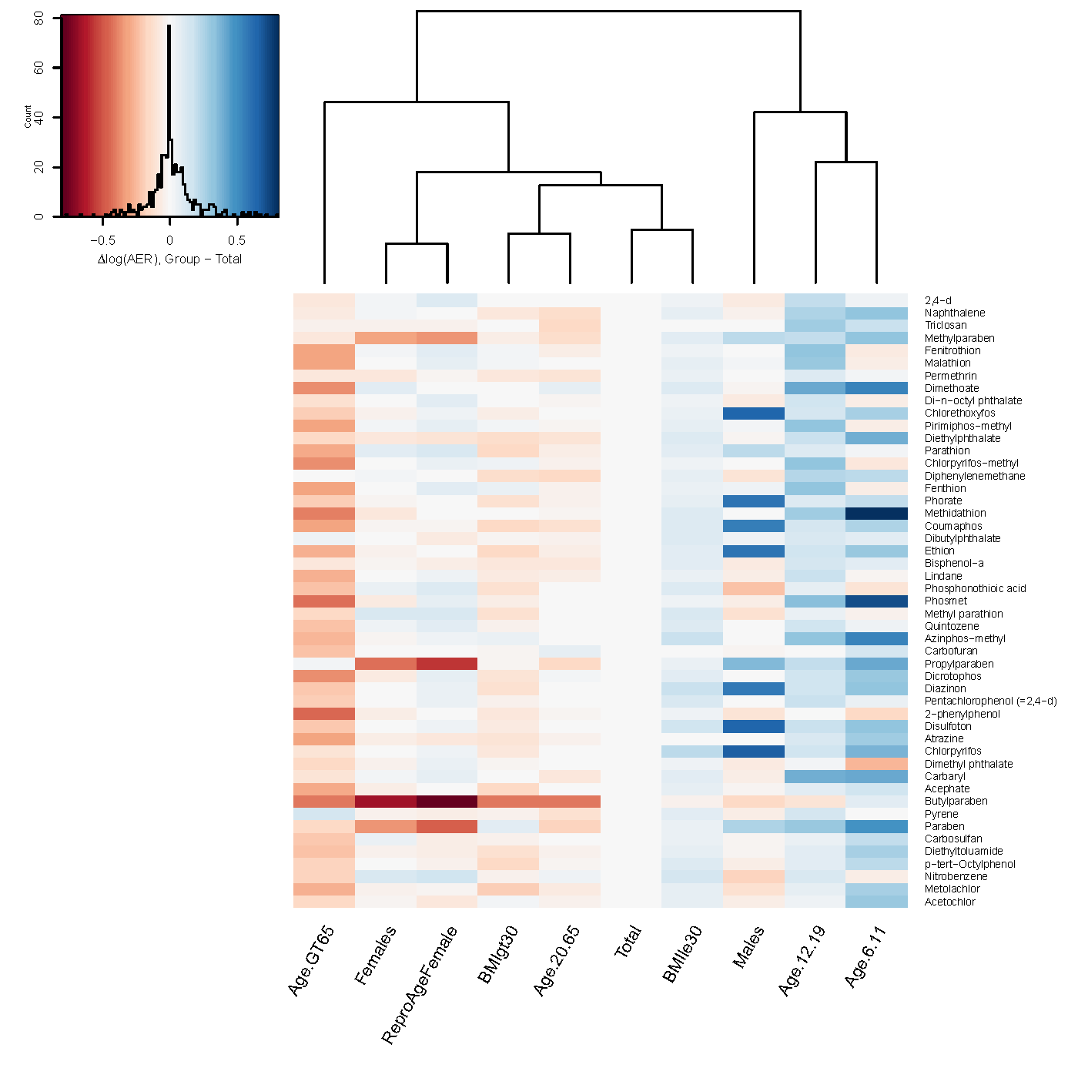
Life-stage and Demographic Specific Predictions
Wambaugh et al. (2014) predictions of exposure rate for various demographic groups
New version of httk R package (Ring et al., in preparation) allows prediction of parameters based on actual NHANES biometrics
Change in Risk
Work by Caroline Ring (NCCT)

Slide 16
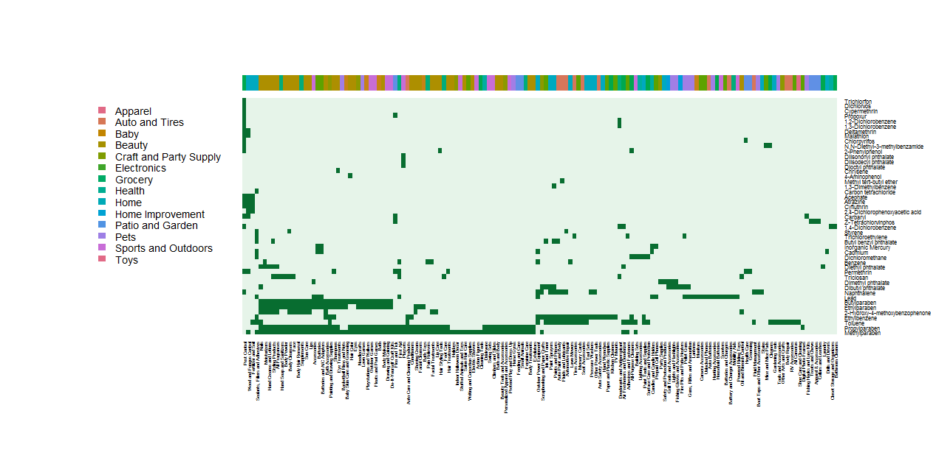
Chemical Use Identifies Relevant Pathways
>2000 chemicals with Material Safety Data Sheets (MSDS) in CPCPdb (Goldsmith et al., 2014)
Predictions with High Throughput Stochastic Human Exposure Dose Simulator (SHEDS-HT) (Isaacs et al., 2014)
105 NHANES Chemicals

Slide 17
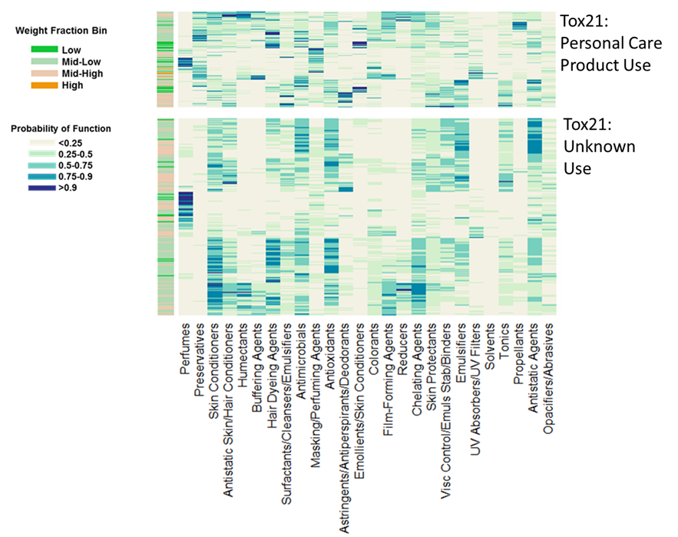
Predicting Chemical Constituents
Unfortunately CPCPdb does not cover every chemical-product combination – using machine learning to fill in the rest
Predict functional use and weight fraction for Tox21 chemical library
Office of Research and Development
Isaacs et al. (submitted)

Slide 18
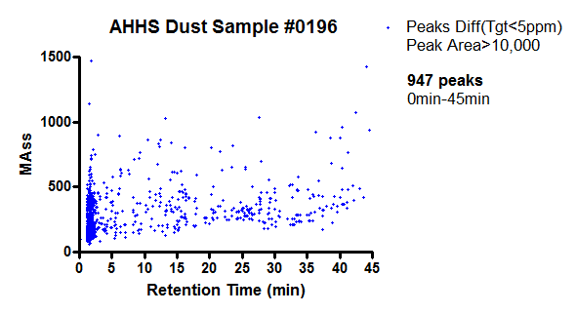
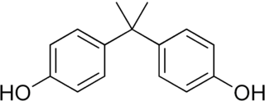
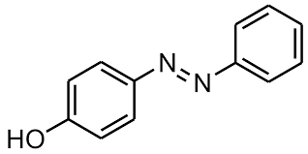
Suspect Screening and Non-Targeted Analytical Chemistry
Each peak corresponds to a mass of a chemical or (depending on technique) fragments of that compound
947 Peaks in an American Health Homes Dust Sample
Mass
Multiple chemicals can have the same fragments or overall mass
Retention Time
Is chemical A present, chemical B, or both?
We are now expanding our identity libraries using reference samples of ToxCast chemicals
See poster “Linking High Resolution Mass Spectrometry Data with Exposure and Toxicity Forecasts to Advance High-Throughput Environmental Monitoring” by Julia Rager, et al.

Slide 19

Exposure Screening Tools for Accelerated Chemical Prioritization (ExpoCast)
Contracts were awarded (December, 2014) to Southwest Research Institute and Battelle
Phase I (Pilot) Examining capabilities and feasibility
Assay | Unit | Pilot Order | Contractor Lead Researcher | Lead EPA Post-Docs
High Throughput Screening- Level Physico-Chemical Properties Measurement (VP, pKa, Henry's Law, Kow) | compound | 200 | Alice Yau (SWRI) | Chantel Nicolas and Kamel Mansouri
Determine Chemical Constituents of products, materials, articles (screening level) | test object | 20 classes of product, 5 samples each | Alice Yau (SWRI) | Katherine Phillips
Determine chemical emission rate from specific products, materials, articles | test object | 100 | Anne Louise Sumner and Tom Kelly (Battelle) | Chantel Nicolas
Screening for occurrence of large numbers of chemicals in sample acquired by contractor (biological media) | sample | 500 blood samples (likely from Indianapolis) | Anne Gregg (Battelle) | Caroline Ring

Slide 20
ExpoCast Biomonitoring
Screening for occurrence of large numbers of chemicals in sample acquired by contractor (biological media)
Research Conducted by Battelle Memorial Institute (Anne Gregg)
Cohort is a mixed gender and race group of adults from Indianapolis
Sample Screening
One extraction method resulting in two aliquots for analysis
Two analysis methods GCxGC TOFMS and LC-TOFMS
In addition to 200 priority ToxCast chemicals, we will look for NHANES chemicals as reference

Slide 21
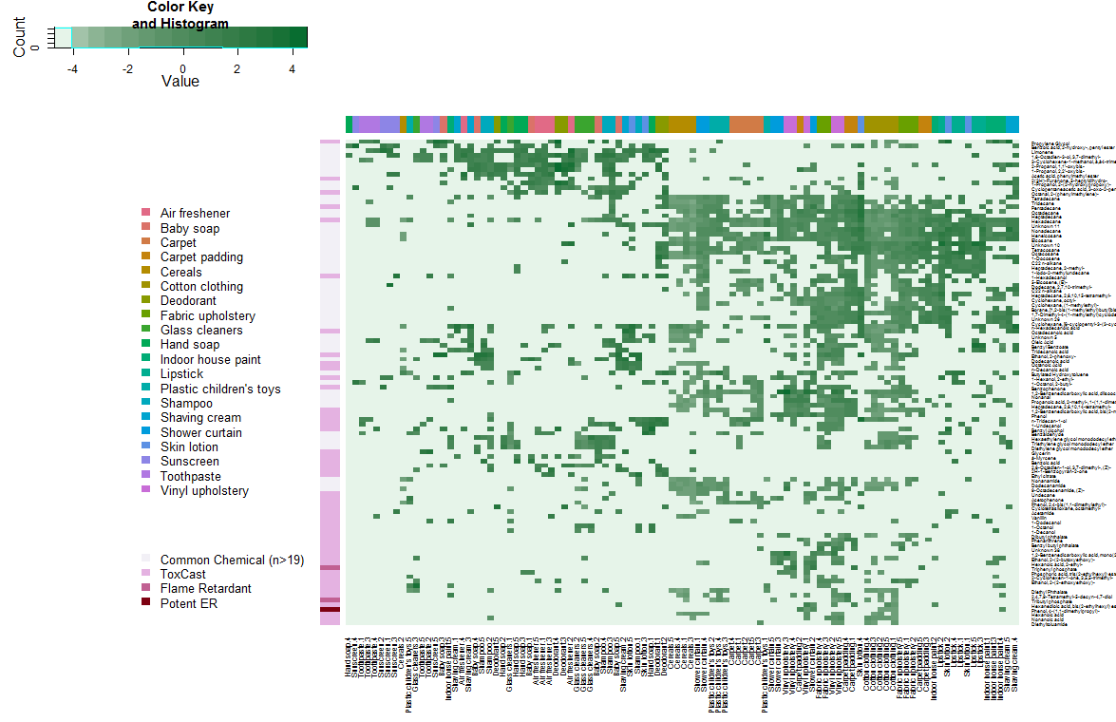
ExpoCast Consumer Product Scan
Log₁₀ (µg/g)
Commonly Found Chemicals
GC-MS with DCM Extraction
Results from Alice Yau (SWRI)

Slide 22
High Throughput Exposure (HTE)
There are low levels of thousands of xenobiotic chemicals present in the metabolome, relating these to exposures and health effects is an important unsolved problem
Can use a combination of forward modeling and reverse inference from biomarkers to predict exposure
Broader monitoring data informs evaluation of those predictions
Better chemical use data informs models predicting exposure
Toxicokinetics (TK) provides a bridge between HTS and HTE by predicting tissue concentrations due to exposure
New R package “httk” freely available on CRAN allows statistical and other analyses of 543 chemicals (ToxCast + pharmaceuticals)
The views expressed in this presentation are those of the author and do not necessarily reflect the views or policies of the U.S. EPA

Slide 23
Chemical Safety for Sustainability (CSS) Rapid Exposure and Dosimetry (RED) Project
Collaborators
Arnot Research and Consulting
Jon Arnot
Battelle Memorial Institute
Anne Louise Sumner
Anne Gregg
Chemical Computing Group
Rocky Goldsmith
Hamner Institutes
Harvey Clewell
Cory Strope
Barbara Wetmore
NCCT
Chris Grulke
Richard Judson
Dustin Kapruan
Chantel Nicolas
Robert Pearce
James Rabinowitz
Ann Richard
Caroline Ring
Woody Setzer
Rusty Thomas
John Wambaugh
Antony Williams
NRMRL
Yirui Liang
Xiaoyu Liu
NERL
Craig Barber
Brandy Beverly
Derya Biryol
Kathie Dionisio
Peter Egeghy
Kim Gaetz
Brandall Ingle
Kristin Isaacs
Katherine Phillips
Paul Price
Mark Strynar
Jon Sobus
Mike Tornero-Velez
Elin Ulrich
Dan Vallero
National Institute for Environmental Health Sciences (NIEHS)
Mike Devito
Steve Ferguson
Nisha Sipes
Kyla Taylor
Kristina Thayer
*
*
*
*
*
NHEERL
Jane Ellen Simmons
Marina Evans
Mike Hughes
*
Netherlands Organisation for Applied Scientific Research (TNO)
Sieto Bosgra
*
Research Triangle Institute
Timothy Fennell
*
*Trainees
*
Silent Spring Institute
Robin Dodson
Southwest Research Institute
Alice Yau
Kristin Favela
Summit Toxicology
Lesa Aylward
University of California, Davis
Deborah Bennett
University of Michigan
Olivier Jolliet
University of North Carolina, Chapel Hill
Alex Tropsha
The views expressed in this presentation are those of the author and do not necessarily reflect the views or policies of the U.S. EPA

